Slide 1
The Muscle System
Chapter 7

Slide 2
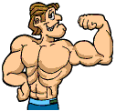
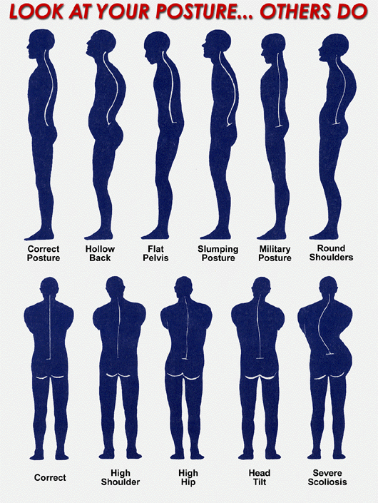
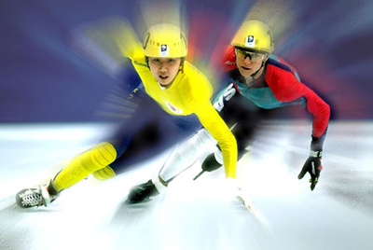
Muscle Functions:
Produce movement of the skeleton
Maintain body posture and body position
Supports soft tissue
Guards entrances and exits
Maintains body temperature

Slide 3
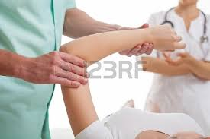
New Words!
Myology
The study of muscles
Orthopedics
The branch of
medicine that deals
with bones and muscles

Slide 4
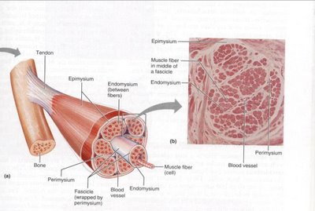
Composition
Muscles are made up of:
Connective tissues
Blood vessels
Nerves
Skeletal muscle tissue
Each cell of a muscle is called a “fiber”

Slide 5
Two Groups of Muscles
Axial musculature (head-torso)
Positions head, vertebrate, and moves rib cage
Makes up approximately 60% of muscles
2. Appendicular musculature
attached to bones that move arms & legs
Used for movement
Make up approximate 40% of muscles

Slide 6
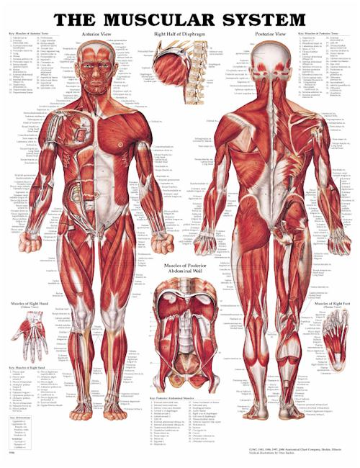
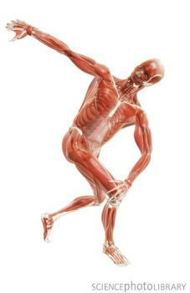
Muscles of the Body
The body has approximately 700 muscles!
Makes up about 40% of our weight!

Slide 7
Muscles Attachments
Origin
end of muscle that attaches to immovable part
Gastrocnemius: distal portion of the femur

Slide 8
Muscles Attachments
Insertion
end of muscle attached to a movable part
Gastrocnemius inserts on the calcaneus

Slide 9
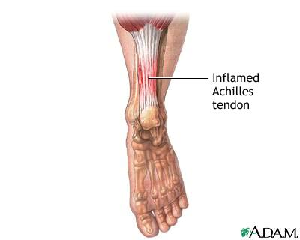
Muscles Attachments
Tendon
tough connective
tissue band
connecting a muscle
to a bone

Slide 10
Muscles Attachments
Ligament
Cord of fibrous tissue that connects bone to bone

Slide 11
Muscles Attachments
Aponeurosis
fibrous or membraneous sheet; expanded tendon

Slide 12
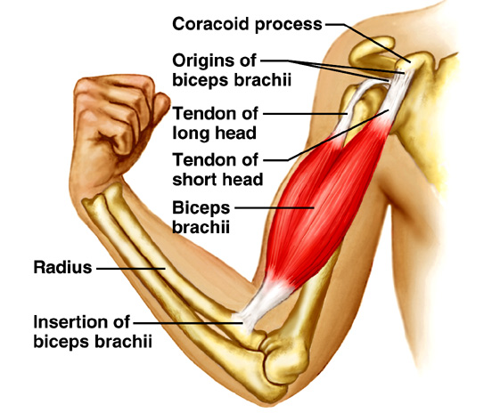
Each muscle begins at an origin
Stationary
Each muscle ends at an insertion
Moves closer to the origin of a muscle during a muscle contraction

Slide 14
Interactions
Prime Mover
aka: agonist
muscle responsible for a particular body movement
Biceps brachii– flexes the elbow

Slide 15
Interactions
Antagonist
muscle that opposes a prime mover
Triceps brachii –extends the elbow (opposes the biceps brachii)

Slide 16
Interactions
Synergist
muscle that assists action of a prime mover
Deltoid acts to lift arm away from body –supraspinatus assists

Slide 17
Interactions
Fixator
a kind of synergist that holds a bone in place relative to the body while a usually distal bone is moved
scapula muscles hold scapula in place while other muscles contract to move the humerus

Slide 18
Muscles Classifications
ARRANGEMENT OF FASCICLES
can determine the power of a muscle
and how much a muscle can shorten.
Types of fascicle arrangements include:

Slide 19
Classification
Fusiform “f”
Thick in middle, tapered ends
Contractions are moderately strong
ex~ biceps brachii, gastrocnemius
Parallel “j”
Long, strap-like, uniform width, parallel fascicles
Contractions weaker
ex~ sartorius, rectus abdominus, zygomaticus

Slide 20
Classification
Convergent “k”
Broad at origin converging toward a narrower insertion
Relatively strong because fascicles exert tension on a relatively small insertion
ex~ pectoralis major

Slide 21
Classification
Pennate
Feather-shaped; fascicles insert obliquely on a tendon that runs the length of the muscle
Unipennate: fascicles from 1 side “g”
Bipennate: fascicles from both sides “h”
Multipennate: shaped like feathers; “i”
Quills converging on a single point

Slide 22
Classification: pennate cont’
Unipennate: “g”
Palmar interosseous
Semimembranosus (thigh)
Extensor digitorum longus
Bipennate: “h”
Rectus femoris
Multipennate: “i”
Deltoid

Slide 23
Classification
Circular
form rings around body
openings
ex~ orbicularis oris,
orbicularis oculi,
anal, urethral

Slide 24
5 Golden Rules
With a few exceptions, all muscles cross at least one joint.
Typically, the bulk of the muscle lies proximal to the joint crossed.
All muscles have at least two attachments: the origin and the insertion.

Slide 25
5 Golden Rules cont’
Muscles can only pull, they never push.
During contraction, the muscle insertion moves toward the origin.

Slide 26
Nomenclature: 6 Criteria
1. Size
Major (large)
Maximus (largest)
Minor (small)
Minimus (smallest)
Longus (long)
Brevis (short)

Slide 27
2. Shape
Rhomboideus (rhombodial)
Trapezius (trapezoidal)
Teres (round/cylindrical)
Deltoid (triangular)

Slide 28
3. Location
Capitis (head)
Cervicis (neck)
Pectoralis (chest)
Thoracis (thorax)
Abdominis (Abdomen) Femoris (femur, thigh)
Brachii (arm)
Carpi (wrist)
Digiti (finger/toe) Superficialis (superficial)
Profundus (deep)

Slide 29
4. Orientation
Rectus (straight)
Transversus (transverse)
Oblique (slanted)

Slide 30
5. Number of Origins
Biceps (2 heads)
Triceps (3 heads)
Quadriceps (4 heads)

Slide 31
6. Action
Adductor (adducts a joint)
Abductor (abducts a body part)
Flexor (flexes a body part) Extensor (extends a joint)
Levator (elevates a body part)
Depressor (depresses a body part)

