Slide 1
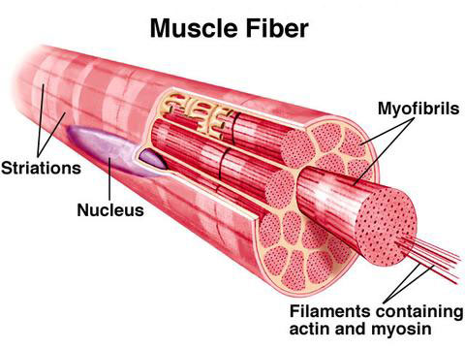
Skeletal Muscle Histology

Slide 2
Structure
Fascia
sheet of fibrous connective tissue (CT) that encloses a muscle
# 79
may project beyond! forming tendon or mesh w/ periosteum

Slide 3
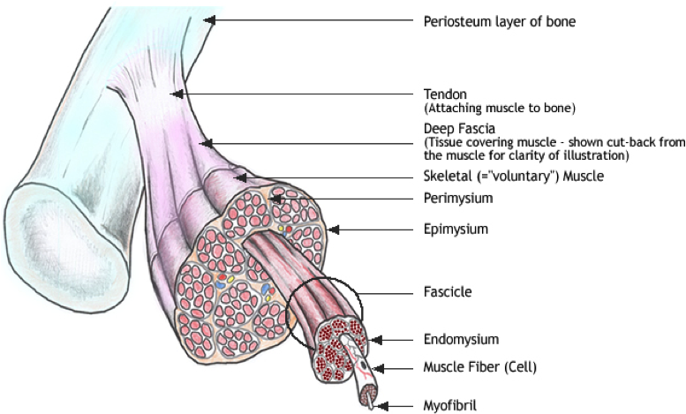

Slide 4
Structure cont’
Epimysium
outer sheath of CT surrounding a skeletal muscle
# 77

Slide 6
Structure cont’
Muscle Fascicle [pl. fasciculi]
bundles of skeletal muscle fibers (parallel) in small compartments
# 71 and # 78

Slide 8
Structure cont’
Perimysium
sheath of CT that encloses bundle of muscle fibers
# 74

Slide 10
Structure cont’
Myofiber (muscle fiber) AKA: muscle
cell!
a single cell that contracts/relaxes in response to stimulation
# 70 and # 72

Slide 12
Structure of MYOFIBER
1) Sarcolemma
#66 and see “A”
cell membrane
invaginations of transverse tubules (T-tubules) [see “C”] connecting to reticulum

Slide 13
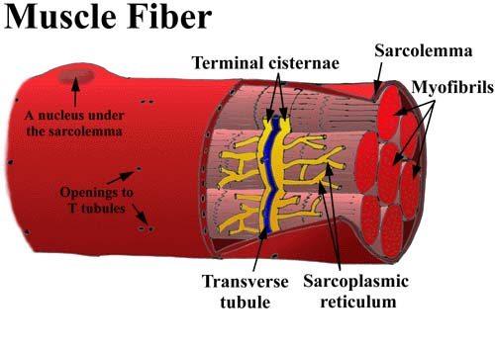

Slide 14
Structure of MYOFIBER cont’
Sarcoplasm
# 67
cytoplasm of muscle cell
contains small, oval nuclei and mitochondria and
myoglobin [see “D”] (similar to hemoglobin; stores O2 for mitochond.)

Slide 16
Structure of MYOFIBER cont’
Sarcoplasmic reticulum (SR)
See “B”
membranous network of channels and tubules w/i a muscle fiber
together w/ T-tubules activate muscle contraction when stimulated

Slide 17
Structure of MYOFIBER cont’
Endomysium
sheath of CT that surrounds each muscle fiber
# 73 and # 75

Slide 19
Structure of MYOFIBER cont’
Myofibril
contractile fibers w/I muscle cell
# 68 and see “E”

Slide 21
MYOFIBRIL structure
Myosin myofilament [see “H-1”]
a protein in combination w/ actin contracts and relaxes muscle fibers
resembles golf club with end called cross-bridge that binds to actin

Slide 22
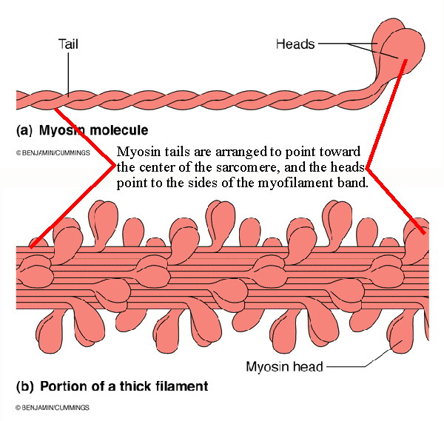

Slide 23
MYOFIBRIL structure
Actin myofilament [see “G-1”]
a protein in combination w/ myosin contracts and relaxes muscle fibers
resembles strands of pearls made of troponin and tropomyosin

Slide 24
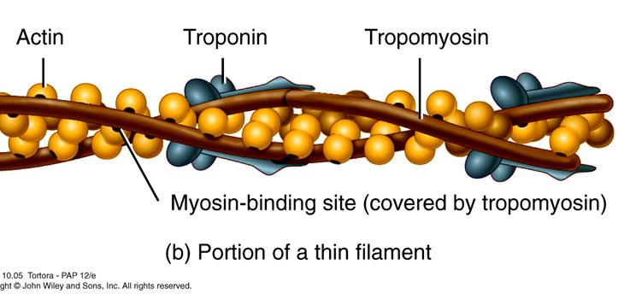

Slide 25
Structure cont’
Sarcomere [see “F”]
structural and functional unit of a myofibril
extending from z- line to z- line [see “F-1”]
Z-discs are dense areas of protein

Slide 26
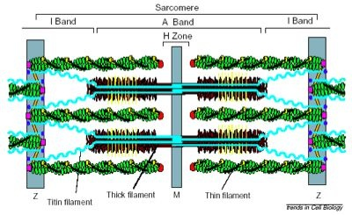

Slide 27
Structure cont’
Striation pattern
I Band (light [see “G”]
composed of thin, actin filaments, attached to z-line
A Band (dark) [see “H”]
composed of thick myosin filaments overlapping with thin actin filament
H zone [see “J”]
a narrow, light zone in center of sarcomere consisting of only myosin which is anchored at the M-line (see “K”) in a dark-stained thickened band

Slide 28
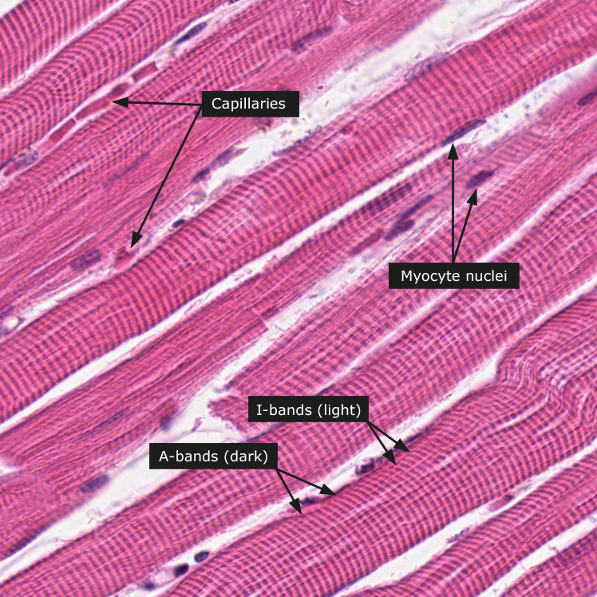

Slide 29
Got Muscle Histology?

