Slide 1
A Muscle Contraction

Slide 2
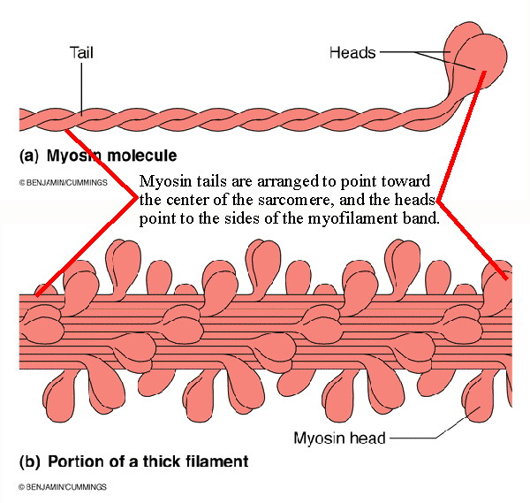
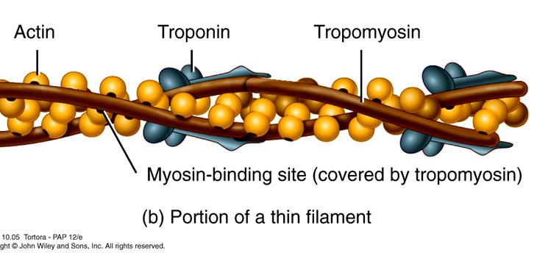
Role of Actin & Myosin (review)
Myosin
thick
like golf club
Actin
thin
like double pearl strand

Slide 3
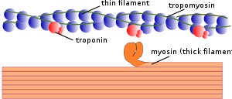

Slide 4
Stimulus for Contraction
Action Potential: rapid depolarization and repolarization of the cell membrane
Depolarization: change from resting membrane potential [charge difference btw. the outside of the cell membrane (+) compared to the inside (-) ]
Repolarization: change back to resting membrane potential

Slide 5
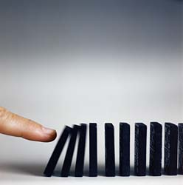

Slide 6
A Nerve Impulse
http://highered.mcgraw-hill.com/sites/0072495855/student_view0/chapter14/animation__the_nerve_impulse.html

Slide 7
Sliding Filament Theory
http://highered.mcgraw-hill.com/sites/0072495855/student_view0/chapter10/animation__sarcomere_contraction.html

Slide 8
Events:
An Action Potential travels along an axon to
a NeuroMuscular Junction .
2) Acetylcholine is released from the synaptic
vesicles of the neuron .
3) Acetylcholine diffuses across the synaptic
cleft and binds to receptor molecules in the
muscle cell membrane .

Slide 9
Events: (cont’)
4) An Action Potential is initiated in the muscle
cell and travels along the sarcolemma and
transverse tubules to the sarcoplasmic
reticulum .
5) Calcium ions are released from the SR .

Slide 10
Events: (cont’)
6) Calcium ions bind to troponin causing
tropomyosin to move into the actin groove
exposing the myosin binding sites .
7) The heads of the myosin myofilaments attach
to the actin myofilaments forming
crossbridges .

Slide 11
Events: (cont’)
The heads of the myosin myofilaments bend
causing actin myofilaments to slide over the
surface of the myosin myofilaments .
Muscle contraction requires energy. ATP bound to the myosin heads is broken down releasing energy to myosin heads which is used to supply the energy for movement.

Slide 12
Events: (cont’)
Another ATP binds to the myosin head, causing it to release the actin myofilament and the myosin bends back to its resting position.
As long as calcium remains attached to the troponin, and as long as ATP remains available, the muscle continues to contract and steps 7-10 are repeated .

