Slide 1
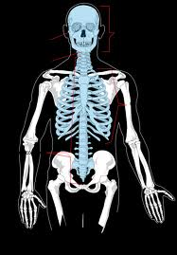
Axial Skeleton
Vertebrae / Thoracic Cage

Slide 2
Vertebral Column
26 bones:
24 single vertebra
the sacrum
the coccyx
avg. length = 71 cm (28 “)
curvature: 4 spinal curves

Slide 3
Vertebral Regions
Cervical (7)
“neck” labeled C1 – C7
atlas (C 1)
holds up head
can nod as in affirmative

Slide 4
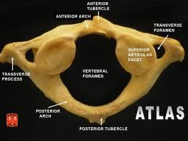
Atlas

Slide 5
Cervical cont’
axis (C 2)
permits rotation
shaking head “no”
Curve is secondary: with balance of head

Slide 6
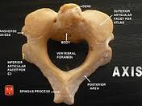
Axis

Slide 7
Vertebral Regions
Thoracic (12)
“chest” labeled T 1- T 12
greater bone mass; -shaped
Curve is primary: with organ enlargement

Slide 8
Vertebral Regions
Lumbar (5)
“lower back” labeled L 1 – L 5
most massive; least mobile
supports most body weight

Slide 9
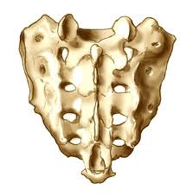
Vertebral Regions
Sacrum
5 fused; fusion completed btw. ages 25-30
Primary curve forming in late fetal development

Slide 10
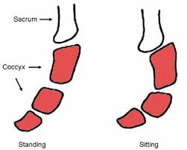
Vertebral Regions
Coccyx
fusion of last 4-5 incomplete until late adulthood
provides attachment site

Slide 11
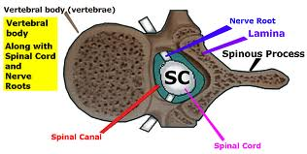
Vertebral Features
Body

Slide 12
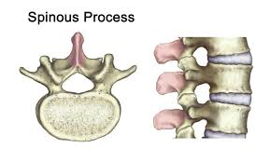
Vertebral Features
Spinous
process

Slide 13
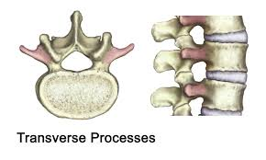
Vertebral Features
Transverse
process

Slide 14
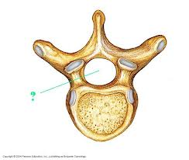
Vertebral Features
Vertebral
Foramen

Slide 15
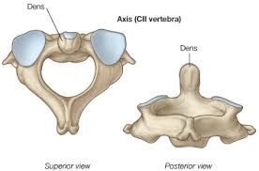
Vertebral Features
dens

Slide 16
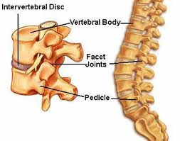
Vertebral Features
facets

Slide 17
Thoracic Cage
Includes
thoracic vertebrae
ribs
sternum
protects & aids in respiration

Slide 18
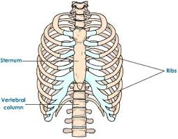
Thoracic Cage
Ribs
costal bones
12 pair: elongate, flattened
#1 - 7 = true
#8 - 12 = false
2 floating no attachment

Slide 19
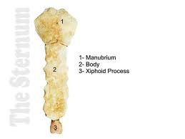
Thoracic Cage
Sternum
Aka : breastbone
structure 3 parts: manubrium, body, xiphoid process

Slide 20
