Slide 1
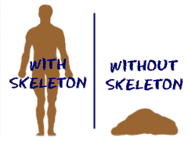
SKELETAL SYSTEM

Slide 2
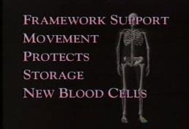
Functions
Shape and support
Storage of minerals, lipids
Blood cell production
Protection
Leverage

