Slide 1
Integumentary System

Slide 2
Functions
1.Protection:physical & chemical barrier; bacteria, water-proofing
2.Temperature maintenance:
3.Synthesis & storage: of nutrients
4.Sensory Reception:
touch, pressure, pain, temp.
5.Excretion & secretion:
perspiration, milk

Slide 3
Components
1. Cutaneous membrane
A. composition
1) superficial epithelium (epidermis)
2) underlying C.T. (dermis)
2. Accessory Organs
A. Hair
B. Nails
C. Exocrine Glands

Slide 4
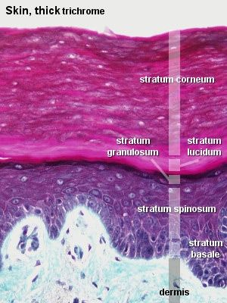
Cutaneous Membrane: aka skin
1. Epidermis:
thick skin → palms & soles vs thin → rest of body
A. Strata: layers

Slide 5
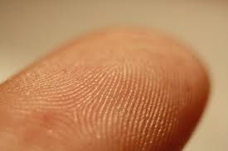
1) stratum germinativum (aka: basale)
a) deepest layer firmly attached to basement membrane
b) forms epidermal ridges that extend into the dermis increasing the surface area for diffusion of nutrients from blood vessels

Slide 6
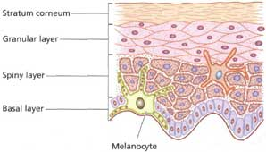
Epidermis cont’
c) ridge contours increase friction & are genetically determined (in finger tips → finger prints)
d) continuous generation & growth of new cells
e) contain
melanocytes

Slide 7
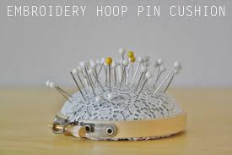
2) stratum spinosum
a) spiney layer
b) cells resemble miniature pin cushion dye to cytoplasmic shrinkage

Slide 8
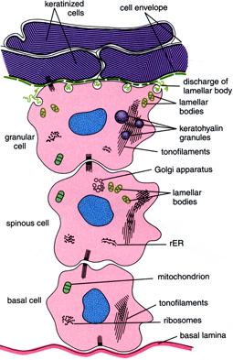
3) stratum granulosum
a) grainy from keratin formation
b) durable,
water-resistant,
basic structure of
hair, calluses, nails

Slide 9
4) stratum lucidum
a) clear layer found ONLY in soles & palms
b) densely packed cells

Slide 10
5) stratum corneum
a) 15-30 layers
flattened, dead
epithelial cells
b) tightly connected
by desmosomes
so shedding is in
sheets

Slide 11
c) accumulate large amounts of keratin, hence “keratinized/cornified”
d) 2-4 weeks for cell to reach this layer
e) normally relatively dry so unsuitable for microorganism growth

Slide 12
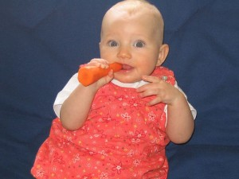
B. Pigmentation
1) caused by interaction between pigments and blood flow
2) carotene
A) yellow – orange
pigment accumulating
in epidermal cells
B) can be converted
to vitamin A

Slide 13
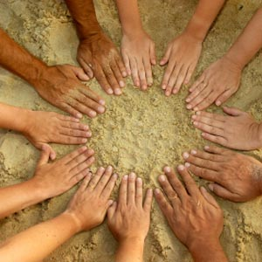
3) melanin
a) brown, yellow-brown, or black
b) produced by melanocytes; synthesized from molecules of amino acid tyrosine & stored w/i intracellular vesicles; transferred to germinativum & color entire epidermis

Slide 14
c) UV radiation from sunlight benefits by stimulating synthesis of vitamin D3
d) color differences are genetically, environmentally, and physiologically determined from activity of melanocytes

Slide 15
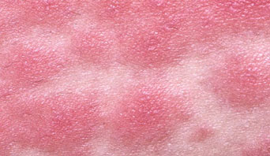
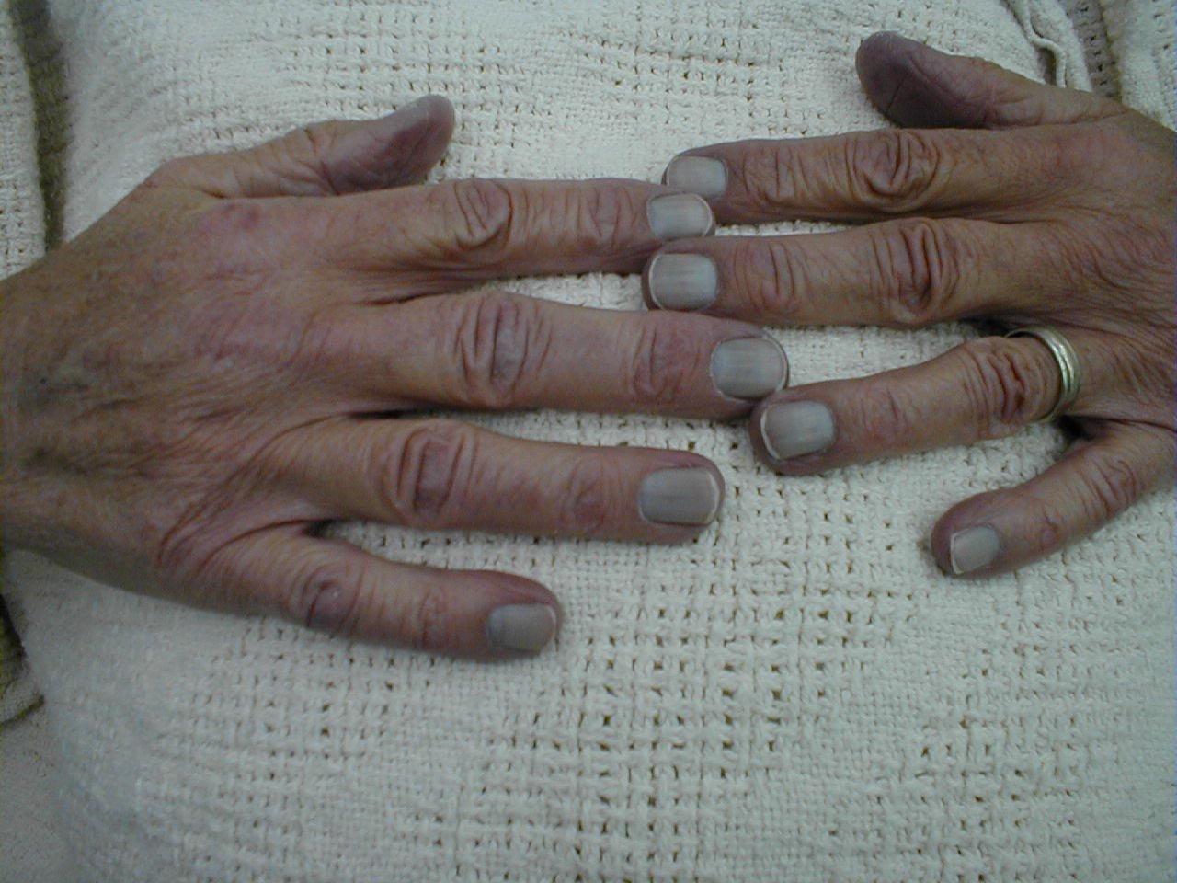
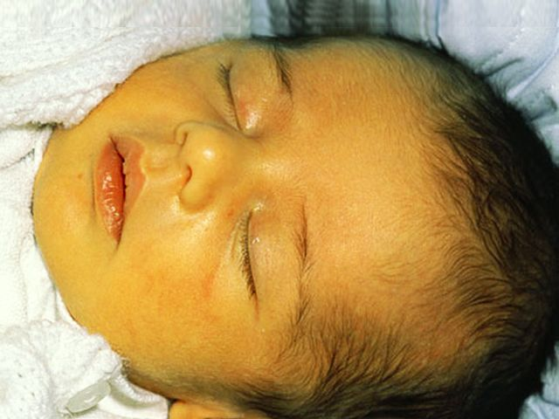
4) alterations
a) erythema
b) jaundice
c) cyanosis

Slide 16
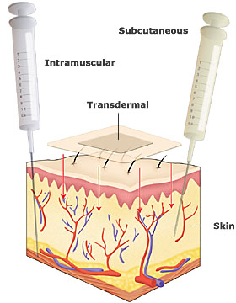
C. Drug administration
1) lipid-soluble solvents can be carried across membrane
2) movement is
slow until dermal
vessels are reached

Slide 17
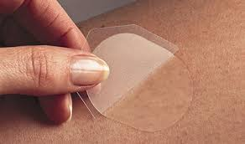
3) transdermal administration via patch
a) highly concentrated
b) Examples
(1) scopolamine
(2) estrogen
(3) estrogen & progesterone
(4) nicotine

Slide 18
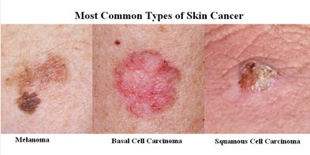
D. Cancer (CA)
Skin cancer is most common type

Slide 19
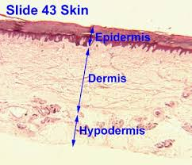
Cutaneous Membrane cont:
2. Dermis:
a. Function
1) binds dermis to epidermis
2) communication w/ other systems (CV, lymph, nervous)

Slide 20
a. Composition
1) papillary (upper) region
a) loose C.T. that supports and nourishes the epidermis
b) Dermal papillae: finger-like projections extending upward btw epidermal ridges enhancing surface area for delivery of nutrients, etc.
c) contains capillaries & nerves supplying surface of skin

Slide 22
a. Composition cont’
2) reticular (lower) region
a) deeper meshwork of dense, irregular C.T.
b) composed of both elastic and collagen fibers for flexibility / prevent damage
c) contains hair follicles, sweat glands, blood vessels, nerves, pressure receptors, etc.

Slide 23
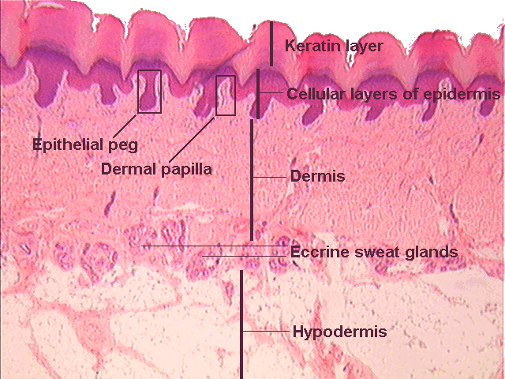
Dermis Regions

Slide 24
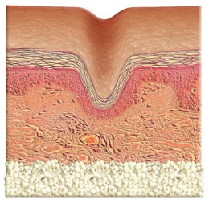
d) alterations in C.T. cause wrinkling and cancer

Slide 25
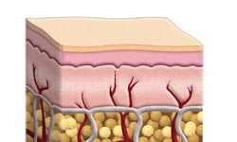
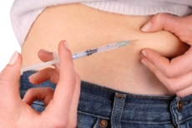
Cutaneous Membrane cont:
3. Subcutaneous (hypodermis):
a. Function
1) stabilizes position of skin
2) insulates

Slide 26
b. Composition
1) loose C.T. w/ fat cells
2) providing infants & small children w/ baby fat to reduce heat loss
3) provides for energy reserve and shock absorption
4) elastic, no vital organs →
useful for injections for
administering drugs

Slide 27
c. Aging : distribution changes
beginning at puberty
1) men → neck, upper arms,
lower back, buttocks
2) women → breasts, hips, & thighs
3) both to belly

Slide 28
Questions ?

