Slide 1

Human Life

Slide 2
Functions of Life
Different organ systems have different functions thereby performing unique roles in physiology.

Slide 3
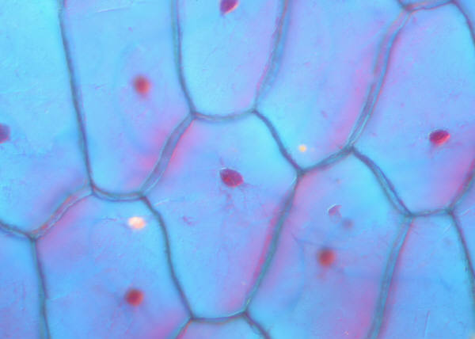
Organization
Trillions of cells organized to maintain distinct internal compartments.
cell membrane: contains/separates
blood vessels: contains/separates
nerves & muscles: wrapped in C.T. to
separate
skin: barrier

Slide 4
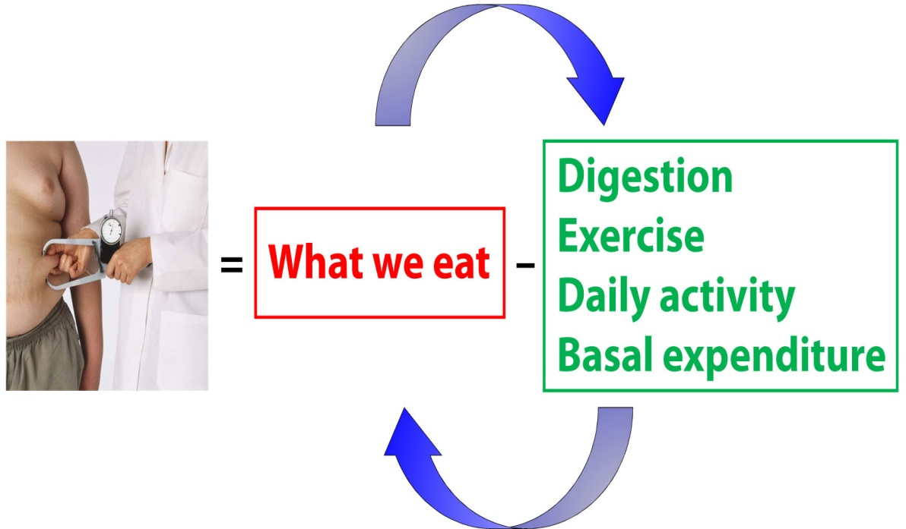
Energy Transfer/Metabolism
First Law of Thermodynamics
Energy can neither be created
nor destroyed-- it can only
change form.

Slide 5
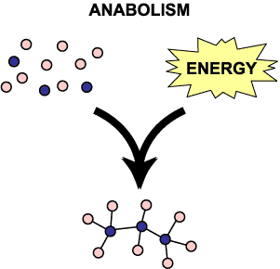
Energy Transfer/Metabolism
Anabolism: smaller, simpler molecules combined into larger more complex substances

Slide 6
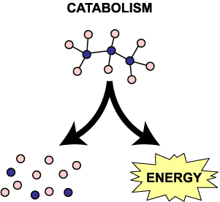
Energy Transfer/Metabolism
Catabolism: larger more complex substances are broken down into smaller simpler molecules

Slide 7
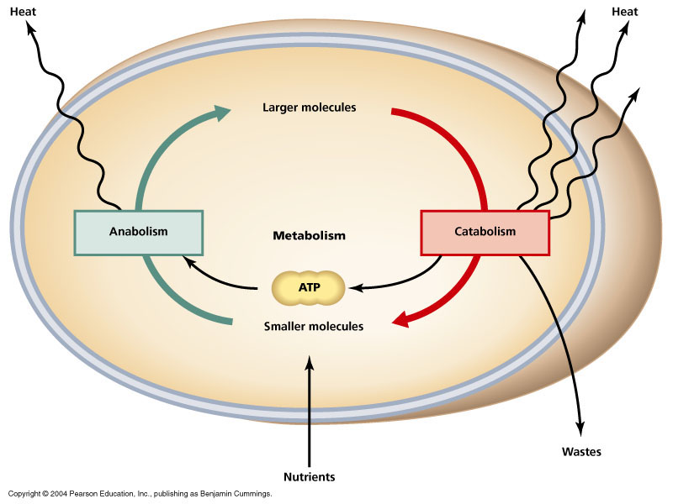
Energy Transfer/Metabolism
Metabolism: sum of all anabolic and catabolic reactions that take place in the body

Slide 8
Energy Transfer/Metabolism
Examples in the body
  Respiration
  Digestion
  Excretion
  Absorption
  Assimilation

Slide 9
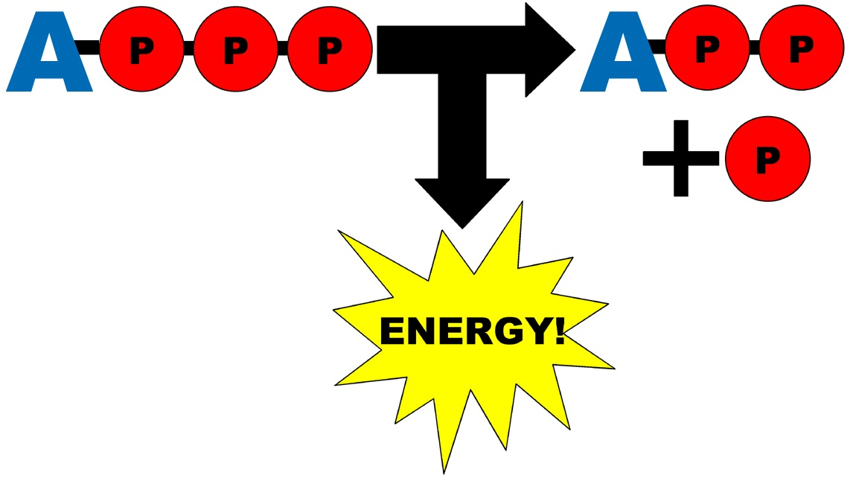
Energy Transfer/Metabolism
ATP
Adenosine triphosphate
Every cell uses to store and release
energy!

Slide 10
Responsiveness
ability of an organism to adjust to changes
  Irritability: responding to change in immediate environment
  Adaptability: adjusting to longer-term changes
    Examples
      move toward food/water
      dog barking at strangers
      fish scared by noise
      amoebas move toward prey
      heavier coat in winter/migrating
      workout → sweat

Slide 11
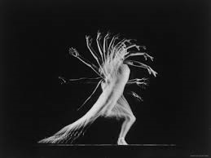
Movement
transportation both internally and externally
actions of joints, organs, cells
  coordinating muscle group actions for breathing, heartbeat, digestive tract
  skeletal muscles (voluntary)
  glands secreting
  blood cells moving through
  blood

Slide 12
Development
changes in the body through life including
Differentiation: cell specialization due to a differential gene expression
Growth: increase body size by increasing number of cells, amount of cellular material, and size of some cells
Renewal: formation of new cells for growth, repair or replacement
Reproduction: formation of new organism from parent organism

Slide 13
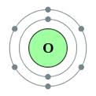
Maintenance of Life
Oxygen (O2)
  gas making up 20% of the air
  key component in chemical reactions
  releases energy from food substances

Slide 14

Maintenance of Life
Nutrients :substances essential to survival
  Macronutrients (required in large amounts)
    1) Water
      body’s functional chemicals dissolved/
      transported
      environment for chemical reactions
      most abundant component (70% mass)
      regulates temperature
      cushions, protects, lubricates

Slide 15
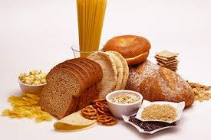
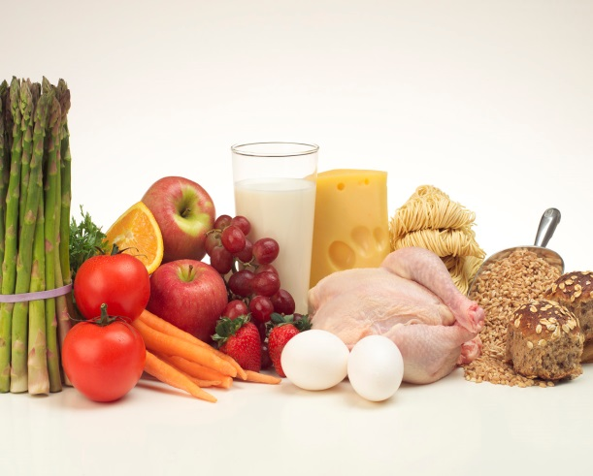
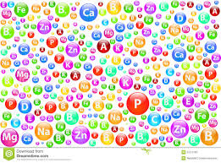
Maintenance of Life
Nutrients
  Macronutrients (required in large amounts)
      1) Energy-Yielding :carbs, lipids
    2) Body Building :proteins
  Micronutrients
  1) Vitamins
  2) Minerals

Slide 16
Maintenance of Life
Temperature
  a measurement of heat (product of metabolic reactions)
  narrow range for chemical reactions

Slide 17
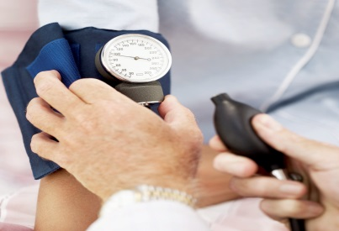
Maintenance of Life
Pressure
  force exerted by a substance in contact with another substance
  Dynamic pressure (aka~hydrostatic)of body fluids: BP must be great enough to enable blood to reach all tissues yet low enough not to cause problems with blood vessels
  Atmospheric : exerted by the mixture of gases (N2, O2) in atmosphere

Slide 18
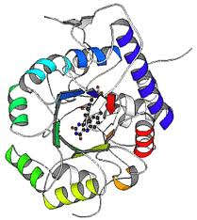
?? Questions ??

