Slide 1
Hemostasis
sequence of responses that stops bleeding when blood vessels are injured
a process
sometimes referred to as coagulation
co= together agul = gluing ation = process

Slide 2
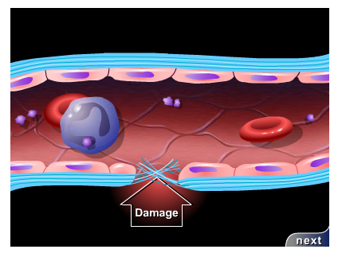
Injured blood vessel

Slide 3
Mechanisms of Hemostasis
Vascular Spasm
Platelet Plug formation
Coagulation

Slide 4
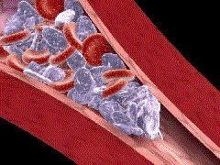
Vascular Spasm
damage causes the smooth muscle in the vessel wall to contract → vasoconstriction
causes decreased blood flow
persists from minutes to hours
platelet attraction
enhances this!

Slide 5
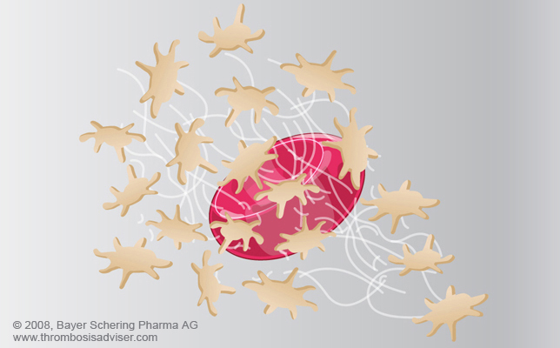
Platelet Plug Formation
platelets stick to collagen fibers forming a mass or plug
Aka: white thrombus
Prostacyclin inhibits
aggregation at other sites
occurs mostly in
arteries

Slide 6
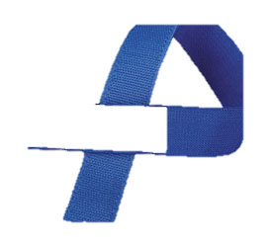
Coagulation
Aka: blood clotting
a complex process of stopping blood flow
series of chemical reactions that culminates in formation of fibrin threads
prevents hemorrhage

Slide 7
General Events in Coagulation
PF₃ : phospholipid that coats surface of platelets and interacts w/ TF, vitamin K, Ca++, and others
TF (tissue factor) produced by platelet cells and damaged tissue
Factor X activated
Prothrombin activator (enzyme) produced

Slide 8
General Events in Coagulation
Prothrombin conversion → thrombin (another enzyme)
Thrombin stimulates fibrinogen → fibrin mesh

Slide 9
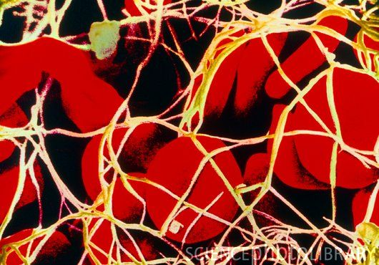
Fibrinogen to Fibrin

Slide 10
Coagulation cont’
Positive feedback loop
Pathways
Extrinsic Clotting Pathway
rapid, within seconds
tissue thromboplastin released resulting in formation of prothrombin activator
Intrinsic Clotting Pathway
More complex
Factors activate each other

Slide 11
Blood Clot
network of thread-like protein fibers that traps blood cells platelets and fluid
Clot : network of insoluble protein fibers = fibrin
Serum:
plasma w/ no fibrinogen or clotting factors
straw-colored liquid
Help stop blood flow, reduce infection and enhance healing

Slide 12
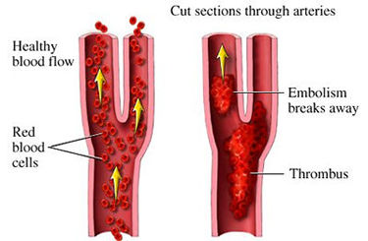
Clot Control
Formation occurs locally due to circulating anti-coagulants:
anti-thrombin
heparin
prostacyclin
Thrombus →
attached
Embolus →
traveling

Slide 13
Clot Retraction
consolidation or tightening of fibrin clot
pulls edges of the damaged vessel closer together, decreasing further damage
fibroblasts form connective tissue and new endothelial cells repair the vessel lining
plasminogen, an inactive plasma enzyme, is incorporated into the clot
body and blood tissues contains substances that can activate plasminogen to plasmin which helps dissolve the clot by digesting fibrin threads

Slide 14
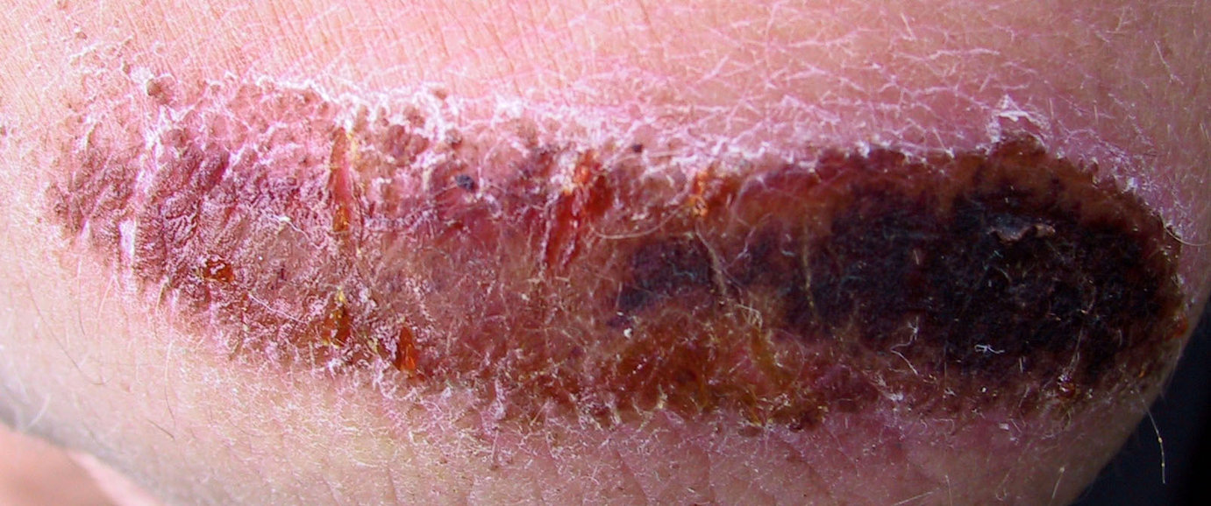
Clot Eradication
Healing over 2-10 days
Tissue plasminogen activator (TPA) causes activation of plasminogen
Plasminogen → plasmin
Plasmin degrades proteins w/i clot

Slide 15
Bleeding Disorders
Thrombocytopenia
Impaired liver function: clotting factors
Vitamin K →required
Hemophilias→ hereditary

Slide 16
