Slide 1
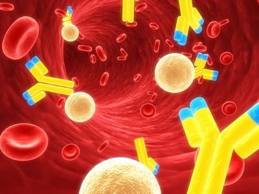
Body Defenses & Immunity

Slide 2
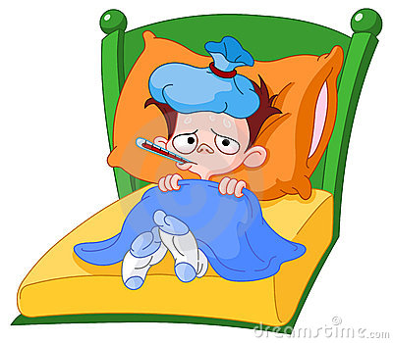
Susceptibility
being vulnerable to a disease or disorder

Slide 3
Resistance
body’s ability to counteract microorganisms or toxins

Slide 4
Types of Resistance
Non-Specific resistance
Directed against ALL pathogens
Specific resistance

Slide 5
Non-Specific Resistance
Skin → in tact!
Eye tearing→washes out /enzymes!
Urinary → removal!
Mucous membranes → trap!
Digestive → enzymes/acids destroy!
Respiratory → moist, hairs,
cough/sneeze → expel!
Lymph → structures trap/fight!

Slide 6
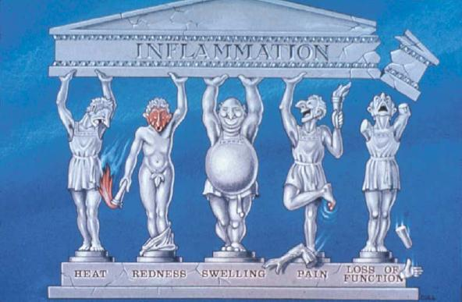
Non-Specific Resistance
Includes:
Inflammation
a protective response of body tissue that increases circulation to an area after irritation or injury

Slide 7
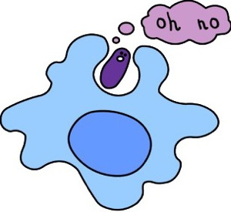
Non-Specific Resistance
Includes:
Phagocytosis
ingestion and destruction of microorganisms

Slide 8
Non-Specific Resistance
Includes:
production of interferon
cell produced protein that protects
production of complement
promotes inflammation; phagocytosis; and rupture of bacteria

Slide 9
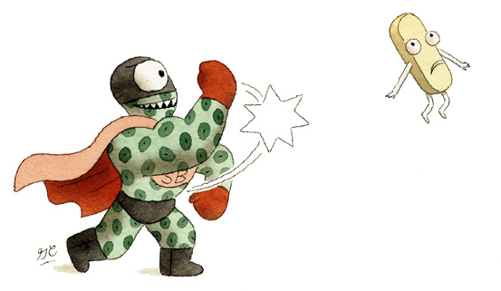
Specific Resistance (Selective)
directed against particular pathogens

Slide 10
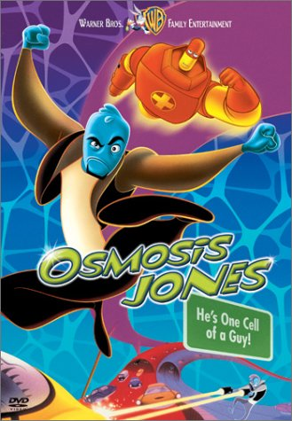
Immunity
body’s ability to counteract effects of infectious organisms

Slide 11
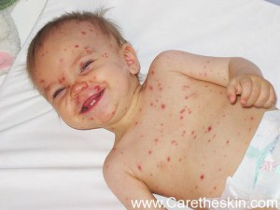
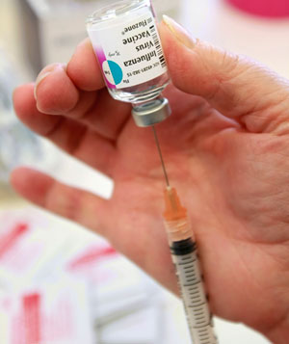
Immunity
acquired by having disease or vaccination

Slide 12
Immune-Reaction
aka: antigen-antibody reaction
attacks/destroys
antigen
any substance that the body regards as foreign (bacterium, virus, toxin)
antibody
disease fighting protein produced in response to presence of a specific antigen

Slide 13
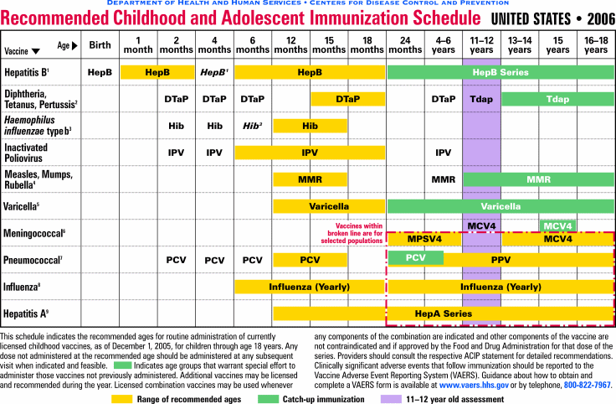
Immunization
process by which resistance to an infectious disease is induced or augmented

Slide 14
Immunity
Active Immunity:
individual’s own body produces an immune response to a harmful antigen
Passive Immunity:
immune agents develop in another person or animal and then are transferred to an individual who was not previously immune

Slide 15
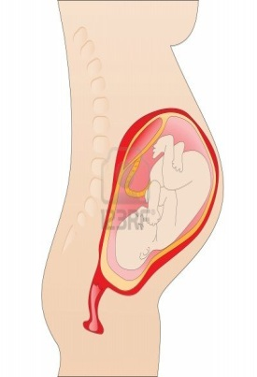
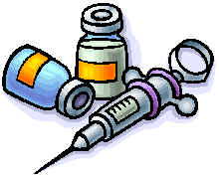
Immunity continued
*recognition of specific antigens is called specific immunity
Natural: individual contracting disease or fetus being exposed to maternal antibodies
Artificial: deliberate action of receiving vaccinations or antibodies

Slide 16
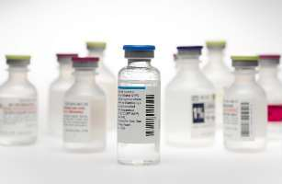
Vaccination
administration of antigenic material (inactivated or killed microbes or their products) to induce immunity
typhoid, diphtheria, polio, measles, mumps, …
administered: orally, by injection, or nasal spray

Slide 17
Immunocompromised
person whose immune response has been weakened by a disease or …
immunosuppressive agent (radiation/certain drugs)
(aka: immunosuppressants)

Slide 18
Immunodeficiency diseases
caused by defect in immune system
characterized by susceptibility to infections and chronic diseases

Slide 19
Immunodeficiency diseases
AIDS
(acquired immune deficiency syndrome)
no cure
prognosis poor
caused by -HIV-1 or HIV-2 (human
immunodeficiency virus)
transmitted by sexual intercourse or exposure to contaminated body fluid

Slide 20
Hypersensitivity
excessive reaction to an antigen
Allergies:
conditions in which the body reacts with an exaggerated immune response to common harmless substances (most from environment)
Anaphylaxis: (anaphylactic reaction)
life-threatening hypersensitivity reactions to previously encountered antigen

Slide 21
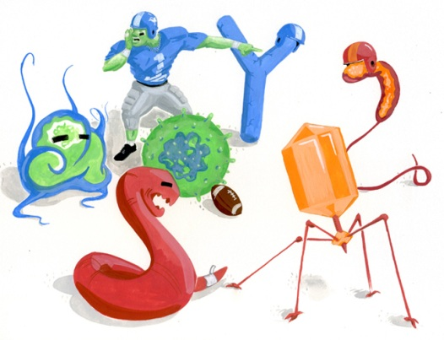
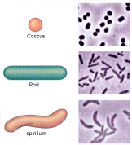
Pathogens
any disease-producing agent
or microorganism
include bacteria, fungi, protozoa, and viruses
types of Bacteria: cocci, bacilli, or spirilla

Slide 22
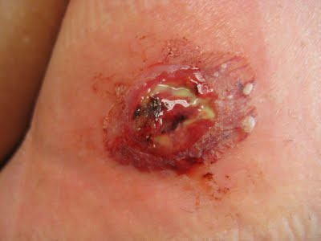
Infection
invasion of the body by pathogenic microorganisms that cause disease

Slide 23
Body Defenses: immune system
benign: favorable for recovery; not having tendency to spread
malignant: tending to grow worse, to spread, and possibly become life threatening (cancer cells)
metastasis: spreading from one part of body to another
metastasize: spread to sites away from where they originate

Slide 24
Bioterrorism
use of pathogenic agents to cause terror in a population
weapons of mass destruction
federal emergency management agency
centers for disease control

Slide 25
Categories of WMD
B iological
N uclear
I ncendiary
C hemical
E xplosive

Slide 26
High Priority Agents
Include microorganisms
Pose risk to national security
Can be easily disseminated or transmitted
Cause high mortality rates and major public health impact
Cause public panic and social disruption
Require special action for public health preparedness

