Slide 1
The cardiac cycle

Slide 2
cardiac cycle
Cardiac cycle: period between the start of one heartbeat and the start of the next
One period of contraction followed by a period of relaxation
Contraction (systole) is when one chamber squeezes blood into adjacent chamber
Relaxation (diastole) is when the chamber fills with blood to prepare for the next contraction

Slide 3
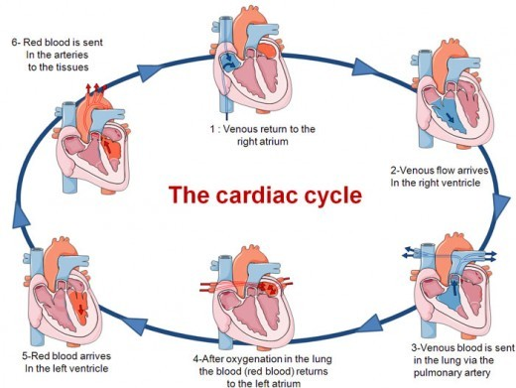
cardiac cycle
Notes:
page 420 in book

Slide 4
pressure
Fluids move from higher pressure to lower pressure
During systole, pressure rises
During diastole, pressure falls
Blood movement to a lower pressure helps ensure that blood flows in only one direction

Slide 5
phases of the cardiac cycle
Atrial Systole
Atria contract and ventricles fill completely with blood
Atrial diastole and ventricular systole
Ventricular systole
Pressure in ventricles rises, causing AV valves to swing shut (part 1)
When the ventricular pressure exceeds the atrial pressure, the semilunar valves open and blood flows into the aorta & pulmonary trunk (part 2)

Slide 6
phases of the cardiac cycle
4. Ventricular diastole
Ventricular pressure rapidly declines
Semilunar valves close when ventricular pressure is lower than arterial pressure
AV valves open when ventricular pressure is lower than atrial pressure
5. All chambers relaxed
Blood flows from major veins through relaxed atria and into the ventricles

Slide 7
Cardiac cycle
Animation

Slide 8
cardiac cycle – other notes
Entire cycle lasts ~800 msec
Atrial diastole is occurring throughout ventricular systole AND ventricular diastole

Slide 9
Potential Problems
Damage to ventricles can lead to heart failure
inadequate pumping out of blood
Heart may beat either too fast or too slow

