Slide 1
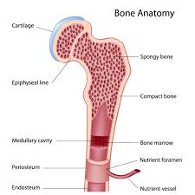
Bone Anatomy

Slide 2
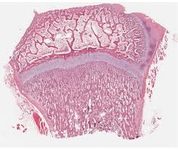
Long Bone Structure
Epiphysis “to grow upon”
end formed from secondary ossification center

Slide 3
Long Bone Structure
Spongy (cancellous) Bone
bars and plates separated by irregular spaces
Characteristics
No osteons
No blood vessels
Nutrients reach osteocytes by diffusion

Slide 4
Long Bone Structure
Function
Aids in reducing weight of bone
Blood cell production in adults
thin layer of compact bone on surface

Slide 5
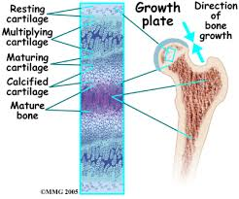
Long Bone Structure
Epiphyseal Plate (disk)
cartilaginous layer within long bone epiphysis that grows
Other: this is the ONLY place that long bones
continue to grow
in length after
birth

Slide 6
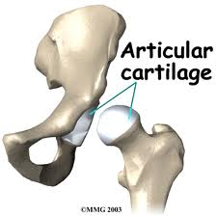
Long Bone Structure
Articular Cartilage
hyaline cartilage that covers ends of bones in synovial joints
cushions jolts and blows to joints

Slide 7
Long Bone Structure
Diaphysis “to grow between”
shaft of long bone

Slide 8
Long Bone Structure
Compact (cortical) Bone
dense tissue; cells are organized in osteons (Haversian systems of canals) with no apparent spaces providing great weight-bearing strength
also found in thin layer around spongy bone of epiphyses
blood vessels are parallel to the surface

Slide 9
Long Bone Structure : diaphysis cont.
2) Medullary Cavity
hollow chamber containing marrow within diaphysis of long bone
Endosteum: tissue lining medullary cavity within bone containing bone forming and bone destroying cells

Slide 10
Long Bone Structure : med. cav. cont.
Function
site of blood cell production in fetus and young children
contains fatty tissue (yellow marrow) in adults
Marrow
Connective tissue in spaces w/i bones that includes blood –forming stem cells
Types
Red and yellow

Slide 11
Long Bone Structure
Periosteum
fibrous, dense irregular connective tissue covering on the bone surface
Function
1) anchors ligaments and tendons
2) helps form and repair bone tissue
3) isolates from surrounding tissue
4) provides route for circulatory/nervous activity

Slide 12
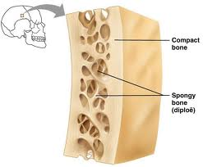
Flat and Other Bones
structure similar to short, irregular, and sesamoid
similar to long
Diploe:
a layer of spongy bone is sandwiched between the external and internal tables of compact bone

Slide 13
Any Questions

