Slide 1
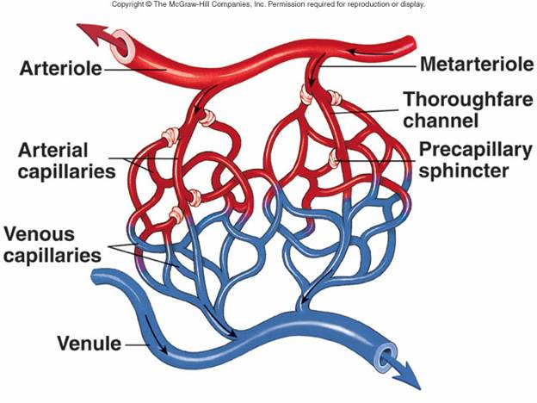
Blood Vessels

Slide 2
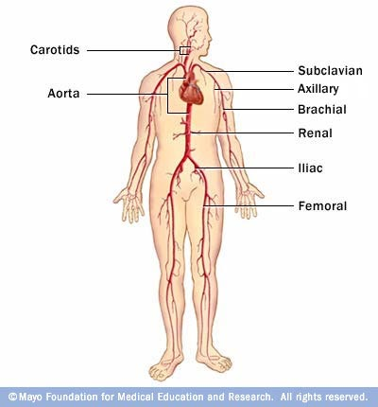
A. Arteries
1. definition: vessel that transports blood AWAY from heart at high pressure

Slide 3
2. Types
a. Elastic arteries
1) largest
2) include aorta &
some of its branches
3) can stretch to accommodate surge of blood as heart contracts

Slide 4
b. Muscular arteries
1) carry blood to specific
organs
2) smaller in diameter,
muscular layer is
proportionately thicker
3) examples: brachial,
femoral, gastric

Slide 5
c. Arterioles
1) critically important
in regulating blood flow
2) function by variable contraction of smooth muscle in walls which increases resistance to blood flow and helps to regulate BP

Slide 6
d. Metarterioles
1) short connecting vessels that connect true arterioles to
capillaries
2) have regulatory valves (smooth muscle called pre-capillary sphincters)

Slide 7
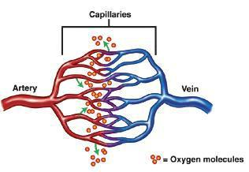
B. Capillaries
1. Structure
a. microscopic b. more than one billion in body
c. distributed non-uniformily
d. activity varies directly with tissue rate of metabolism

Slide 8
2. Function
a. carry blood from arterioles to venules
(small veins)
b. exchange of nutrients and other vital substances

Slide 9
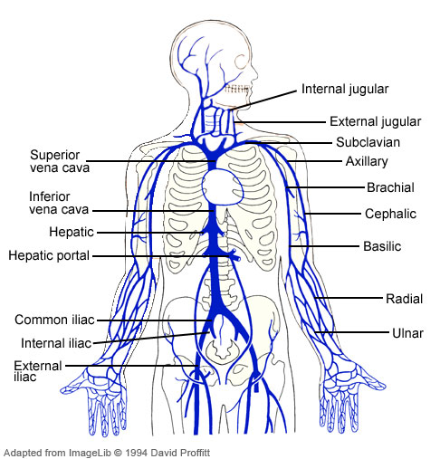
C. Veins 1. definition: vessel transporting blood from capillaries TO heart

Slide 10
2. Venules
a. small-diameter, narrow lumens, and porous, thin walls
b. walls are endothelial cells and a few muscle cells

Slide 11
3. Structure of Veins
a. larger venous channels
b. capacitance: stretch and increase capacity with no pressure change
c. valves: one way to keep blood moving toward the heart

Slide 12
1. endothelial cells 2. fibers
. Overall Vessel Structure

Slide 13
1. endothelial cells
a. provide smooth surface reducing friction
b. inhibits coagulation
c. have intercellular clefts which vary in size & number influencing the diffusion of substances

Slide 14
2. Fibers
a. collagen
1) woven together in wall to strengthen
b. elastic
1) secreted into extracellular matrix
2) organized into circular patterns to
allow recoil
c. smooth muscle
1) not found in capillaries
2) exerts active tension

Slide 15
a. Tunica Externa (Adventitia) b. Tunica Media c. Tunica Intima
3. Layers

Slide 16
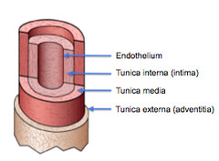
a. Tunica Externa
(Adventitia)
1) outermost, external layer
2) composed of strong, flexible, fibrous connective tissue
3) prevents tearing and anchors

Slide 17
b. Tunica Media
1) middle layer
2) smooth muscle and elastic connective tissue
3) permits changes in vessel diameter
4) innervated by autonomic nerves

Slide 18
c. Tunica Intima
1) innermost layer
2) endothelium continuous with that which lines the heart

