Slide 1
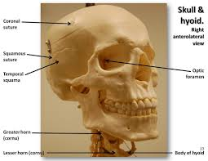
Axial Skeleton
Skull

Slide 2
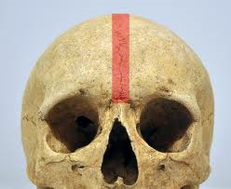
Intro:
A. 22 Bones all interlock (except jaw) along sutures
B. Sutures: immovable joint, such as that between flat bones of skull
C. 8 bones form cranium; 13 form facial skeleton;
1_ mandible (lower jaw) held by ligaments

Slide 3
Cranium Function: encloses cavity / protects brain

Slide 4
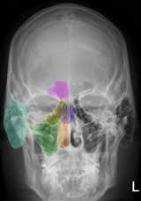
Includes
a) Sinuses
(1) Definition: cavity or space w/i a bone or other body part
(2) paranasal sinus:
(a) Definition: air-filled cavity in cranial bone
(b) Structure: lined w/ mucous membrane; connected to nasal cavity
(3) Function:
(a) decrease weight /increase intensity of voice as resonance chamber
(b) membrane lining moistens/cleans air

Slide 5
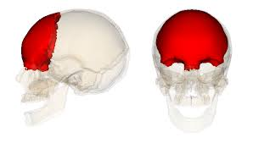
FRONTAL
(1)
anterior #2
supraorbital foramen #11
lateral #13

Slide 6
Parietal (2) anterior #1 coronal suture #3 lateral #1 coronal suture #12

Slide 7
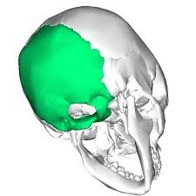
Occipital (1)
lateral #5
lambdoidal suture #3

Slide 8
Temporal (2) anterior #6 lateral #4 squamosal suture #2 mastoid process #8 styloid process #9 zygomatic process #11 ext. auditory meatus #7

Slide 9
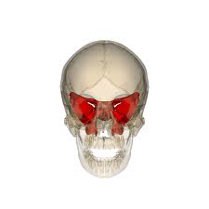
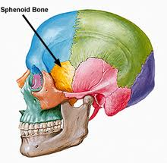
Sphenoid (1)
anterior #7&13
lateral #14

Slide 10
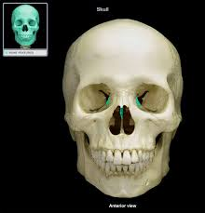
Ethmoid (1) anterior #5 perpendicular plate #8 lateral #15

Slide 11
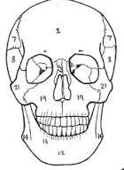
Facial
Function: form basic shape of face; attachment for muscles moving jaw; expression

Slide 12
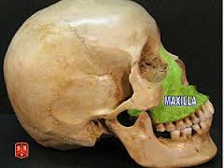
Maxilla (2)
anterior #17
lateral #19

Slide 13
Palatine (2)

Slide 14
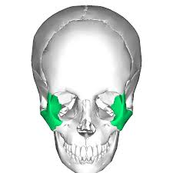
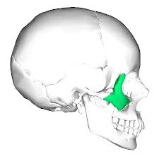
Zygomatic (2)
anterior #14
lateral #18
temporal process #6

Slide 15
Lacrimal (2) anterior #4 lateral #16

Slide 16
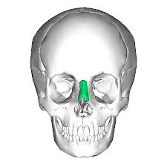
Nasal (2)
Anterior #12
Lateral #17

Slide 17
Mandible (1) anterior # 10 lateral #20

Slide 18
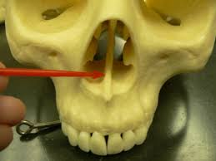
Vomer (1)
anterior #9

Slide 19
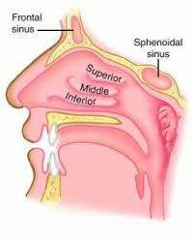
Inferior Nasal Conchae: shape slows air flow; deflects to olfactory receptors anterior #16

Slide 20
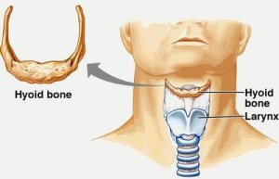
Hyoid (1)

Slide 21
Bones of Ear Malleus (hammer) Incus (anvil) Stapes (stirrup)

